Slide 1
Discussion Framework: IHCL Analytics Offerings & Roadmap
Consumer Analytics Group,
Big Data Initiative

Slide 2
Agenda
Tata Customer Analytics: Company Overview
Analytics Landscape
IHCL Business Priorities & Maturity
Key Opportunities and Two-Year Roadmap
  Quick Wins (0-3 Months)
  Near- Term Opportunities
  Long Term Opportunity : Leveraging Tata Group Data
Data Governance & Privacy
Support Needed & Next Steps (0-3 Months)

Slide 3
Tata Customer Analytics
Company Overview

Slide 4
Tata Customer Analytics Division - Overview
Established as a strategic priority of the Tata Group to enhance customer Value, provide data driven decisions and promote customer centric culture
Data
Key Pillars
Unique Value Proposition
Infrastructure
Cross Organization
Cross Cluster
Intelligence Access
Talent
Predictive Analytics
Optimization
of Productivity
Analytic
Horsepower
Value Proposition
Evolution of Analytics
Decision Support
Decision Making
Decision Support
Decision Making
Optimization
of Resources
Domain
Knowledge
Raw & Cleansed Data, MIS
Business Intelligence & Analysis
Predictive Modeling
Advanced Quantitative Science

Slide 5
Analytics Landscape

Slide 6








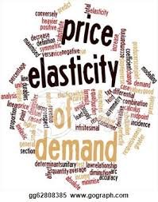


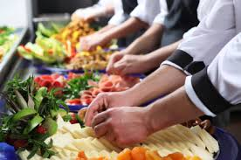

The Four Quadrants of Opportunities in Analytics :
Customer Analytics is our Current Focus Quadrant
Our Year 1 Goal is to lay the foundations in Customer Analytics for IHCL. We will address the Other Quadrants beyond Year 1, based on Business Priority
Customer Insights, Analysis
& Experience
Understand the guest
Revenue Management Analytics
Forecast & optimize demand
Analytics for Operations Management & Sales Effectiveness
Enhance asset productivity
Human Resource Analytics
Forecast skill and employee requirements
Effectively deploy human capital
Understand the drivers for employee engagement
Predict high-potential employee churn
Optimize learning & development initiatives and career management
Gain insights into employee productivity
Reduce credit and operational risks through risk modelling
Reduce raw material sourcing costs though predictive consumption demand
Integrated voice of the customer
Personalize and standardize experience
Enhance campaign effectiveness
Enhance Loyalty Program Effectiveness
Identify the high value & high potential customers
Drive hotel cost optimizations
Predict sales force needs and optimize deployment
Identify drivers of sales effectiveness drivers
Optimize pricing
Maximize impact by room category and length of stay
Track competition rates & pricing
Restaurant Revenue Management – maximize RevPASH
Targeted offerings – Cross / Up sell
Customer channel preference

Slide 7


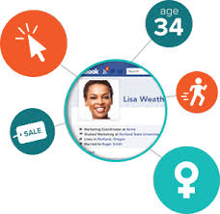












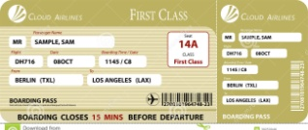

Analytics in the Hospitality Industry
International chains have a fair lead in using cutting-edge analytics to enhance guest experience & revenue
Unique Guest Experience – Omni-channel
Personalized Web Experience
Uniform guest profile across all touch points
Boost Conversion Rates
Extensive customer data : Structured & unstructured big data
Personalized web experience
Guest Profile Manager
Online Profile
Pre-Arrival Welcome
Tiered guest valuation system
Predictive Loyalty
Post-stay
Communication
Personalized Stay
Personalized Arrival
Guest engagement including social media
Data analytics to evaluate and adjust marketing mix
Target “Right People” at the “Right Time”
One Yield – Advanced Revenue Management
“The Price is Right”
Big Data Mined
Who : First class travellers
to Boston
When : This weekend
Targeted Customer Action
Activate curated profiles across media channels – facebook, boarding passes, display ads etc.
Pioneer in Revenue Management Systems – 25 Year history
Made accessible over the internet, prices available on all channels
Improved algorithms
Faster system, prices updated regularly
Extended to group pricing, restaurants & banquets

Slide 8
IHCL Business Priorities
Data, Analytics & Reporting Maturity

Slide 9


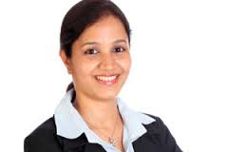

IHCL Business Priorities
The current business imperatives are to understand the guest, increase the effectiveness of the loyalty program and further leverage the digital channel
Understand the Guest
Increase effectiveness of Loyalty Program
Use Digital as a channel more effectively
A
B
C
Develop a single and integrated view of the customer
  Develop an analytics scorecard around the most profitable / valuable customers and how to track them
  Drive the Taj Innercircle Membership: 400,000 1 million
  Active members: 60,000 126,000
  Increase contribution to business from 7% to 10%
  Improve the redemption ratio
  Increase revenues from web (brand.com) from 5.5% to 11%

Slide 10









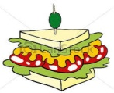



Current IHCL Customer Data Maturity :
High availability of data, with huge opportunities in enhancing quality & usage
Opportunities lie in collecting, organizing & managing data, to enhance its adoption and usability
Taj systems have evolved with the company, but often in a disparate manner
The wealth of customer data being captured is a valuable asset whose potential will be realized when we further transform this into knowledge and intelligence
 | Traditional Data | Availability | Quality | Usage
 | Profiles (Demographics) | ◕ Loyalty ◑ Others | ◕ Loyalty ◑ Others | ◑
 | Transaction History | ◕ | ◕ | ◑
 | Feedback Surveys | ◕ | ◕ | ◑
 | Standard Preferences | ◑ | ◔ | ◑
 | Relationships | Zero | NA | NA
 | Contact History Data Mart | ◑ | ◑ | ◔
 | External Data Sources | ◔ | ◔ | ◔
Availability | Quality | Usage | Big Data
◑ | ◑ | ◔ | Web Traffic Data
◑ | ◑ | Zero | Call Logs
◑ | ◑ | ◔ | Social Media
◔ | ◔ | Zero | Derived Preferences / Passions
Zero | NA | NA | Email Text Sentiment
◕ High ◑ Medium ◔ Low Zero: Non-existent

Slide 11
Current & Desired IHCL Analytics Maturity :
Traditional analytics with basic tools
Currently, IHCL relies on traditional analytics with very basic tools. The intent is to enable core analytical toolkit to deliver advanced analytical solutions.
Currently present at IHCL
Traditional
Must Haves
Maturation
Segmentation & Profiling
Basic (channel / geography / segment)
Standardized campaigns
Limited monitoring (read / responded)
Basic forecasting, mainly manual
Limited web analytics
Advanced segmentation on demographics
Targeted campaigns, end to end management (design, planning, execution, fulfilment & analysis)
Limited forecasting ability based on past transactions
Basic Revenue Management
Derived guest preferences
Social Media Sentiment Analysis
Harness power of external data
Across demographics, offer/service preference ,feedback /sentiment, interaction channel
Customer Value – current, future & potential
Test Vs Control campaign analysis
Campaign Design incorporates historical learning
Omni-channel Campaign optimization
Forecasting includes macro factors, time series analysis etc. – Advanced Pricing optimization & Revenue Management
Propensity to new offers/services & Next Best Offer
Advanced offer/services bundling
Iterative audits & Validation of models
Offline & Online integration
Real time data analytics
Leverage internal & external data to the fullest
Web, mobile, text, voice & social media analysis linked with social stature
Campaign Management
Predictive
Analysis
Big Data & Advanced
Analysis

Slide 12




IHCL Current & Desired Landscape – Infrastructure & Reporting
Opportunities lie in Data Centralization, Consolidation, Rationalization to further advance Analytical capabilities efficiently
Potential Activities
Activities Enabled
Business
Analysis
Campaign
Predictive
Analytics
Quantitative
Sciences
Business
Analysis
Campaign
Predictive
Analytics
Quantitative
Sciences
Sales
Team
Ops
Team
Fin
Team
Mktg.
Team
Fin
Team
Sales
Team
Ops
Team
Fin
Team
Mktg.
Team
Fin
Team
Single Web-based Delivery Platform
BI
Business Intelligence
Lack of advanced analytic tools
Common Advanced Analytical Tools
Lack of single golden source
Unified Data Management (Consolidated Data Mart)
Data
Files 1
Enterprise Data
Warehouse
Data
Files 2
Data
Files 3
Data
Files 1
Enterprise Data
Warehouse
Data
Files 2
Data
Files 3
Challenges of Current State
Benefits of Desired State
Manual Intervention
Data Analysis Limitations
Space Constraints
Increased complexity
Limited Flexibility
Segmented Business Views
Improved accessibility
Centralization- One version of truth
Improved Governance & Integrity
Efficient & Fast Delivery
Better flexibility & presentation

Slide 13
Key Opportunities &
Two-Year Roadmap

Slide 14



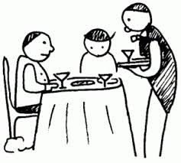





Key Programs and Opportunities
Analytics Opportunities at various stages of customer purchase lifecycle
Profile existing customer base
1. Guest Profiling
2.
Gold Rush
Segment customer base to identify high-value customers
7. Making Smarter Restaurants
8. Smarter Loyalty and Campaign Management
3.
Prospecting
Potential Customers
While Dining:
Modify menu, pricing, recommendations
Identify potential customers from external data sources
4.
Palette Optimization
During Stay:
Delight a guest with personalized offerings based on his past transactions and profile
At the time of Booking:
Display best / most optimal offer
6. A Little Extra
5.
Cross-sell & Upsell
During Booking:
Offer customized packages

Slide 15
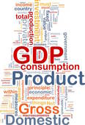



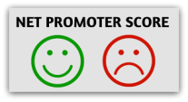



Analytics Roadmap for Y1 & Y2
Phased out key programs based on sources and availability of Data
Quick Wins |  | Foundation | Maturation
0-3 Months |  | 3-12 Months | Beyond 12 Months
 |  |  | Other Quadrants - Revenue Mgmt, Ops & Sales, HR
 |  |  | Offline & Online Integration
 |  |  | Making Smarter Ecosystem (restaurant / spas / banquets)
 | Customer Dashboards | Integrated Reporting and Visualization across company KPIs
 |  | A Little Extra - Personalized Offerings
 |  | Palette Optimization, Cross-sell & Up-sell
 |  | Prospecting Potential Customers
 |  | End to End Loyalty Analytics
Loyalty Campaign Management |  | End to End Campaign Management
Segment High Value Customers
Guest Profiling
Loyalty Database Social Media Data Customer feedback |  | Entire Taj Database External Databases Tata Segment-level Information Website & Call centre data | External Macroeconomic & competition data Taj Operational & Financial Data Tata Group Customer Data
Analytics programs
Scope of
Data to be used

Slide 16
Quick Wins :
(1) Understanding your Guests
(2) Loyalty Program Management

Slide 17










Quick Wins : (1) Know your guests
Smart combination of Guest profiling, segmentation and predictive analytics to generate smarter campaigns
Who are my Customers ?
Profiling and Segmentation
What Offers and Service they want ?
Smart Campaigns
Plan &
Design
Campaign Planning
How do they Interact with me ?
Campaign Design
Contact Management
Campaign P&L
Campaign Design
What do they say about me?
Prioritize
Optimize & Prioritize
Governance policy
Campaign Execution
What Value they generate ?
Execute
QA Processes
What is their future potential ?
Execution
Campaign Fulfillment
Analyze
Campaign Tracking
Propensity to respond to my campaigns/services ?
Analysis
Campaign Analysis
What is the next best offer/service ?
Predictive Analytics

Slide 18

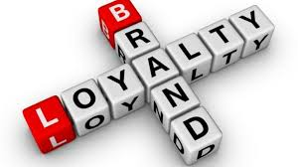

Quick Wins (2) : Loyalty Program Management
End to end loyalty program management includes (a) acquisition (b) loyalty analytics (c) loyalty campaign management
Usage Analytics
(Burn Points)
Activity Analysis
Accrual Analytics
(Earn Points)
Loyalty Active
Loyalty Inactive
Non-Loyalty
Smarter Loyalty Campaigns
Campaign
Planning
Campaign
Design
Prospects
Campaign
Execution &
Fulfillment
Campaign
Analysis
Prospect Data
Multitenant
TATA segments

Slide 19
Customer base categorization: Focus Quick Wins on Loyalty Guests
The entire customer base can be divided in 4 segments based on loyalty and status of customer (active/ inactive) and focus will be on 2 segments – Loyalty (Active and Inactive)
Loyalty
Phase I: Quick Wins
Phase 1 : Quick Wins
Guest Profiling & Segmentation
Design & Execute advanced
Loyalty Campaigns
Loyalty Inactive Customers
Loyalty Active Customers
Inactive
Active
Non-Loyalty Inactive Customers
Non-Loyalty Active Customers
Phase II & Phase III
Non-Loyalty

Slide 20
Near-Term Opportunities
(1) Prospecting
(2) Data Visualization

Slide 21
Near-Term Opportunity (1) : Prospecting customers
Harness external, internal and group level data for quality prospecting
D&B db
National Consumer list club member etc.
International Consumer List
Web data: Tripadvisor, follower of twitter for travel sites
Segment level information from other Tata companies
Filtering criteria: company with Rev> 2cr
Filtering criteria: membership >1 yr
Filtering criteria: Any Indian connection
Stage II: Enrichment based on other Company Data
Data Matching and Merging (if necessary)
Contact number Identification
PROSPECT DATABASE
IHCL Data
Target Profile
Prioritized Target List
Learning
Prospecting Campaign

Slide 22
Near-Term Opportunity (2) : Visualization - Why Visualize ?
Visualization is any technique of creating images, diagrams, or animations to communicate a message and it has been an effective way to communicate both abstract and concrete ideas.
2015 | Delhi |  | Mumbai |  | Bangalore
Month | Price | Sales | Price | Sales | Price | Sales
Jan | 10.0 | 8.04 | 8.0 | 6.58 | 10 | 9.14
Feb | 8.0 | 6.95 | 8.0 | 5.76 | 8 | 8.14
Mar | 13.0 | 7.58 | 8.0 | 7.71 | 13 | 8.74
Apr | 9.0 | 8.81 | 8.0 | 8.84 | 9 | 8.77
May | 11.0 | 8.33 | 8.0 | 8.47 | 11 | 9.26
Jun | 14.0 | 9.96 | 8.0 | 7.04 | 14 | 8.1
Jul | 6.0 | 7.24 | 8.0 | 5.25 | 6 | 6.13
Aug | 4.0 | 4.26 | 19.0 | 12.5 | 4 | 3.1
Sep | 12.0 | 10.8 | 8.0 | 5.56 | 12 | 9.13
Oct | 7.0 | 4.82 | 8.0 | 7.91 | 7 | 7.26
Nov | 5.0 | 5.68 | 8.0 | 6.89 | 5 | 4.74
Average | 9 | 7.50 | 9 | 7.50 | 9 | 7.5
Variance | 10 | 3.75 | 10 | 3.75 | 10 | 3.75
Visualization helps to:
Analyze : Visual Comprehension is much faster than reading
Discover : Interactive visualizations lead to information discovery
Tell a Story : Great speaker use Visuals to make memorable story
Note : Average price & Variance is the same.

Slide 23
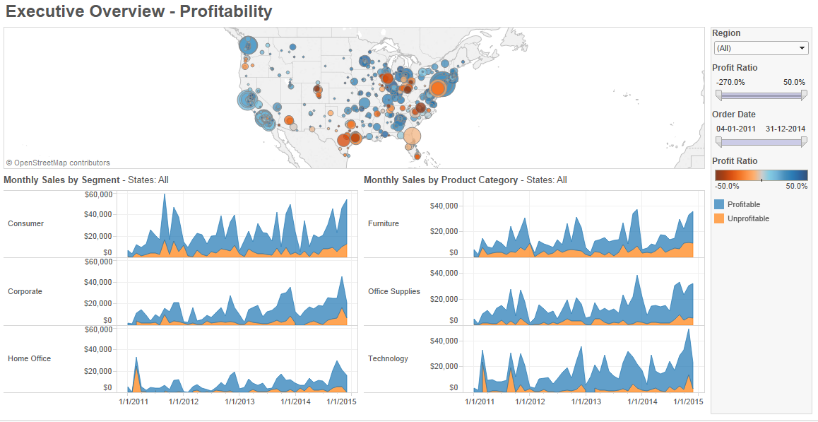
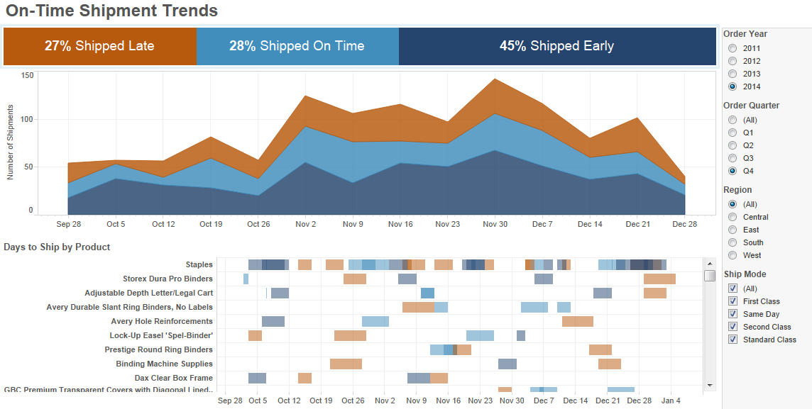
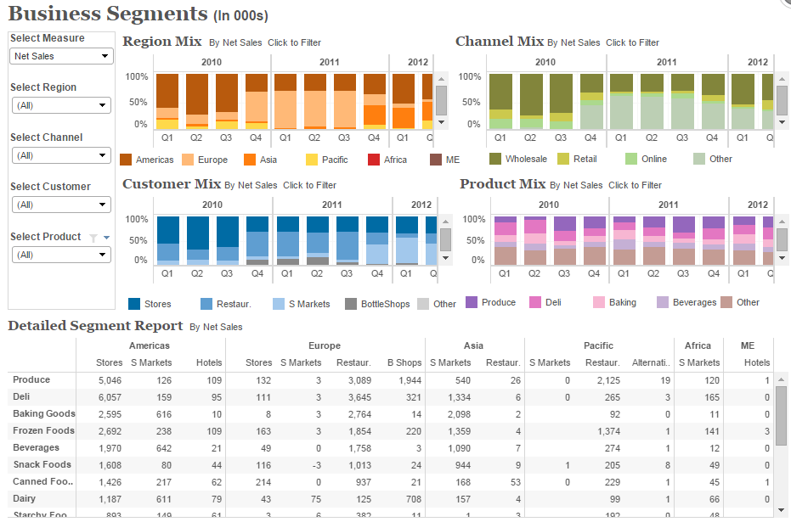
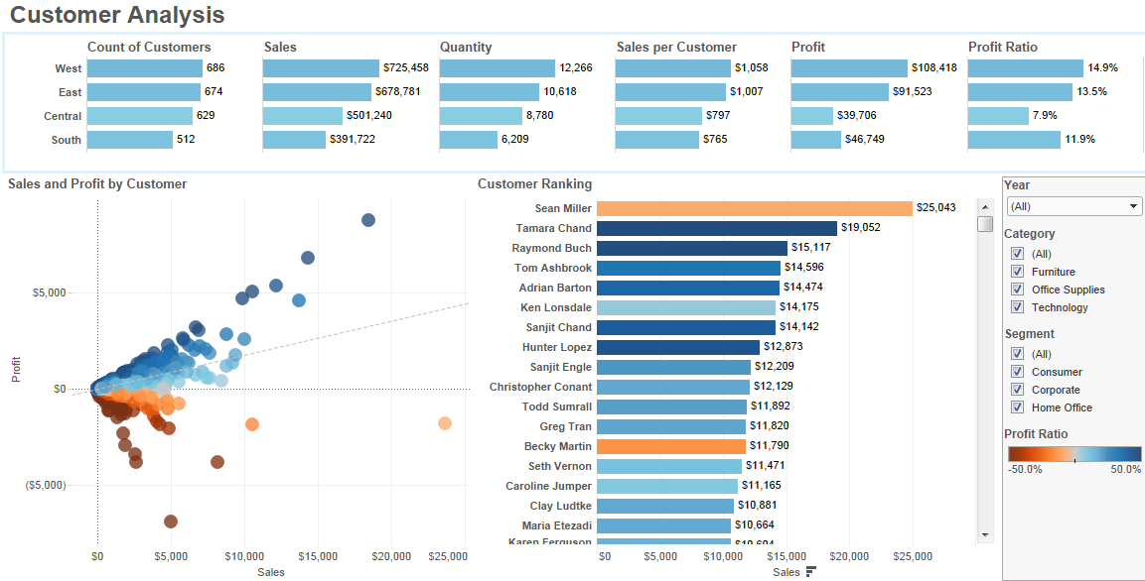
Near-Term Opportunity (2) : Visualization - Examples

Slide 24
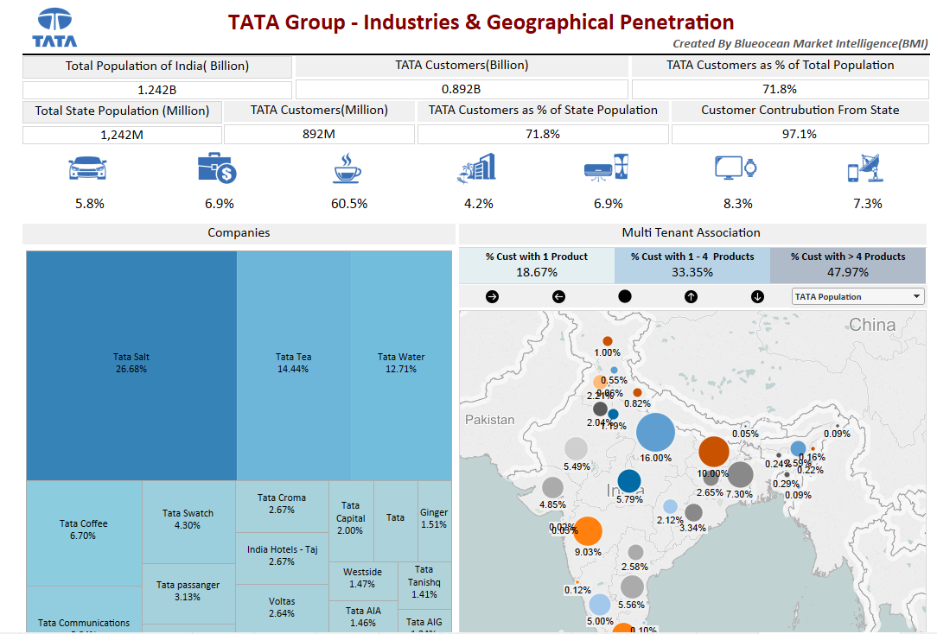
Near-Term Opportunity (2) : Visualization –
POC – One Tata Dashboard
Key Highlights
User has an interactive view of Tata companies across sectors such as retail , financial , hotel etc.
Customer base in each company
Spread across Indian geography for each sector or company
Customers segmentation based on multi-tenant relationship in terms of Number of Tata products bought

Slide 25
Near-Term Opportunity (2) : Visualization –
Company-Wide Key Performance Indicators
Number of credible entries received
Number of Ideas Implemented across multiple hotels
Unaided Awareness (India) & Customer Engagement
RevPAR ranking (Top 25 Hotels)
Aggregate RevPAR
Web Revenue %
Web – Click to conversion ratio
Social Media Reputation
Loyalty Revenue %
Loyalty Membership Base & Active Share
Gross Operating Profit (GOP)
Net Promoter Score (NPS)
Safety: Audit Scores
Safety : Lost Time due to injuries
Number of Hotels in the pipeline
Number of Rooms in the pipeline
NPV of future earnings from pipeline
Retention rates for High Potentials
Retention rates for Bottom Performers
Internal vs. external hires
Women in Leadership Positions
CSR: Talent hiring (Skill training Centers)
Employee Engagement - ESS
IHCL Consolidated EBITDA
Net Consolidated Debt
Net Debt : EBITDA Ratio
ROIC
Net Debt : Equity Ratio
Earnings per Share (EPS)
Innovation
Brand Positioning & Performance
Operations
Develop-ment
Human Capital
Finance

Slide 26
Long Term Opportunity

Slide 27




3 Points of Inflection
Single Tenant
Multi Tenant
One Tata Loyalty Program
Gradual transition from single tenant to multi tenant segment level to multi tenant customer level
Group
Tata Group-wide Loyalty Program
Customer level Data Sharing
Customer attributes across LOBs
One Tata Loyalty program
360 degree view of customer
Cluster
Defined customer segments across various clusters
Segment level information across LOBs
Segment level Data Sharing
No customer linkages
Full view of segment, limited view of customer
Company
Enhanced Customer centricity and Data driven organizations
No Data Sharing
Company level analytics solutions
Limited view of customer

Slide 28
Analytics solutions for Single-tenant relationship with clients
Leverage customer level data on individual Tata companies to derive insights and drive campaigns
Financial
T1
Retail
T2
Hospitality
T3
Illustrative example - Hospitality cluster
Customer holidays frequently in Taj hotels
They prefer Asian cuisine
They are high profile executives paying through Credit cards
They generally book hotels through mobile apps
Cluster
Insights
Data
Demographics
Investments
Transactions
Purchase preference & behavior
Purchase value & frequency
Travel frequency
Hotel and food preferences
Campaign: Find out potential customers for Loyalty program enrollment
Can Do
Cannot Do
Provide customization for upcoming holidays
Loyalty through personalized offers in Taj restaurants on birthdays, anniversaries etc
Provide add-on services on app hotel bookings
Life-stage based offerings
Attitudinal /socio-graphic preferences
Customer passion like sports/music/adventures
Customer value/potential
Risk management
Customer preference for channel, merchant etc
Dynamic Price
Product
bundling
Store positioning
Demand
forecasting
Sales force
optimization
Identify high potential guests
Palette optimization
Loyalty programs
Cross sell
Analytics Solutions

Slide 29


Customer segmentation through Multitenant relationship
Individual campaigns in companies driven by customer attributes across various LOBs
Cluster
Financial
Services
Travel Hospitality
Add-ons to the existing campaigns
Retail
Over lay segment with campaign criterion satisfying customers for increase in conversion rates
Custom Offer to all adventure enthusiast post overlay of segment information at Taj locations
Regional focused marketing leveraging segment preference
Business customers offered add-ons to existing package during conferences/meeting post segment overlay
Urban Dwellers
Empty Nesters
Cosmocrats
Cosmopolitans
Upper class families with dual income and kids
High on holidays, shopping and electronics purchase
Frequent visitors to eating/drinking joints
Segment

Slide 30
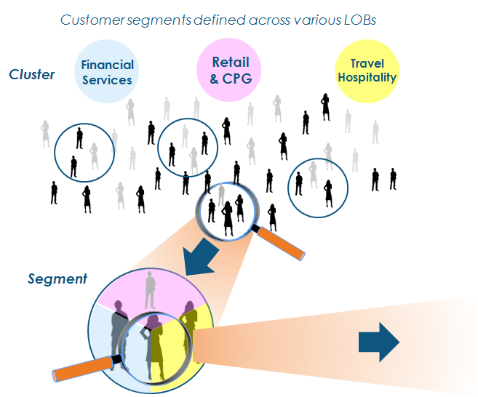
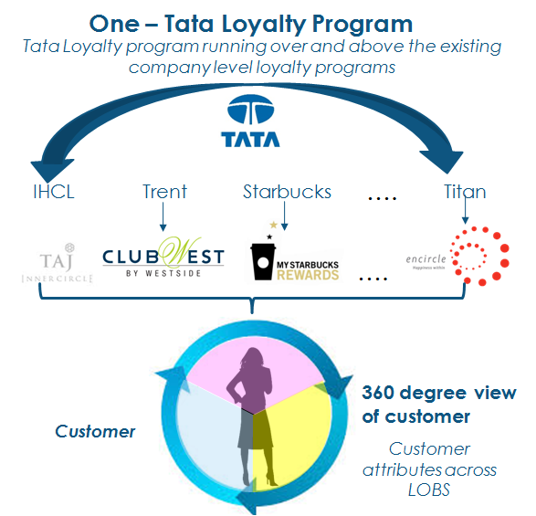
Multi-tenant relationship offering customer level view
Paving the path for a ‘One - Tata Loyalty program’ across various Tata companies

Slide 31
Data Privacy & Governance

Slide 32
Data Protection & Privacy Principles
The relationship between collection and dissemination of data, technology, the public expectation of privacy, and the legal and political issues surrounding them is critical to the venture
Collection:
Capture & Store minimum data as required. Special attention to PII data.
Purpose of Use:
Use the data only for the intended purpose of use agreed with the partner.
Data Security:
Store data on secured environment – Server, Encrypted disks.
Confidentiality:
Limited customer PII information with very minimal access and strong control.
Customer Action:
Ensure that customer communication preferences are respected.
Data Sharing:
Should be done with Companies and customer disclosure and consent

Slide 33
Next Steps

Slide 34
Support needed
Collaborations with the Marketing, Revenue, Legal and IT teams for a smooth engagement
1
Single point of contact for sharing of data
2
Timely sharing of data (with compliances in place)
3
Continuing interaction with marketing team
4
Weekly review with Chief Revenue Officer
5
Monthly Review Meetings with MD / Steering Committee

Slide 35
Next Steps (0- to 3 months)
Immediate roles and responsibilities for the Tata Consumer Analytics Division
Week of | Plan | Detailed Plan | Responsibility
May 18th | Presentation to MD | Present the analytics solutions and roadmap | TCAD
May 18th – May 25th | MOU | Detail the metadata requirements to understand current data maturity | IHCL
 |  | Draft the MOU | IHCL & TCAD
 |  | Sign the MOU for metadata sharing | IHCL & TCAD
May 25th – June 1st | Metadata | Share Metadata with TCAD | IHCL
 |  | Evaluation of Metadata to define Proposal for Phase I | TCAD
June 1st – June 8th | Proposal and Engagement Model | Draft of the proposal for Phase I | TCAD
 |  | Finalize the Activities, Resources and Costing | IHCL & TCAD
 |  | Finalize the Proposal and Engagement model | IHCL & TCAD
June 8th – June 15th | NDA | Draft the NDA with purpose of intent, data sharing &privacy details | IHCL & TCAD
 |  | Sign the NDA | IHCL & TCAD
June 15th - 21st September | Phase I – Revenue Drivers | 3 key initiatives – Clustering, Profiling and Campaigns | IHCL
 |  | *Monthly Review and Feedback | IHCL & TCAD
 |  | *Monthly Review and Feedback | IHCL & TCAD
 |  | Present the results of Phase I | IHCL
* Monthly & Quarterly reviews

Slide 36
Thank You

